Slide 1
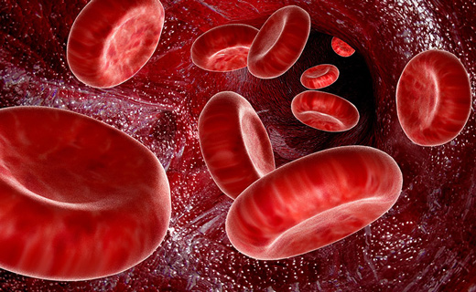
Haemolytic anaemias
Professor of the Department internal diseases
Liskova Yu.V.

Slide 2
Hemolytic Anemia
Definition:
Those anemias which result from an increase in RBC destruction
Classification:
Congenital / Hereditary
Acquired

Slide 3
Red cells defect (mostly inherited)
Membrane abnormalities
Hereditary spherocytosis
Hereditary eliptocytosis
Hereditary stomatocytosis
Hereditary akantocytosis
Paroxysmal nocturnal haemoglobinuria
Haemoglobin abnormalities: qualitive
sickle cell anaemia
anaemias in other stable haemoglobins (C, D, E, etc.)
unstable haemoglobins
haemoglobin-М (high affinity to the oxygen, clinically – cyanosis and polycythemia)
Haemoglobin abnormalities: quantative (α- and β-thalassaemias)
Metabolism: G6PD, Pyruvate kinase deficiency

Slide 4
Anaemias, developing because of external impact (acquired)
Antibodies
Isoimmune: haemolytic disease of newborn, haemolytic transfusion reactions
Autoimmune
Mechanical damage of RBCs
‘March’ haemoglobinuria
Microangiopathic haemolytic anaemia
Chemicals, parasites (malaria)
Haemolytic poisons
High secvestration of RBCs by phagocytosing mononuclears
Anaemias in acute infections
Anaemias in hypersplenism

Slide 5
Haemolytic anaemias
↑↑ serum indirect bilirubin
Reticulo-
cytosis
Jaundice

Slide 6
Notes:
Intravascular Hemolysis

Slide 7
Notes:
Extravascular Hemolysis

Slide 8
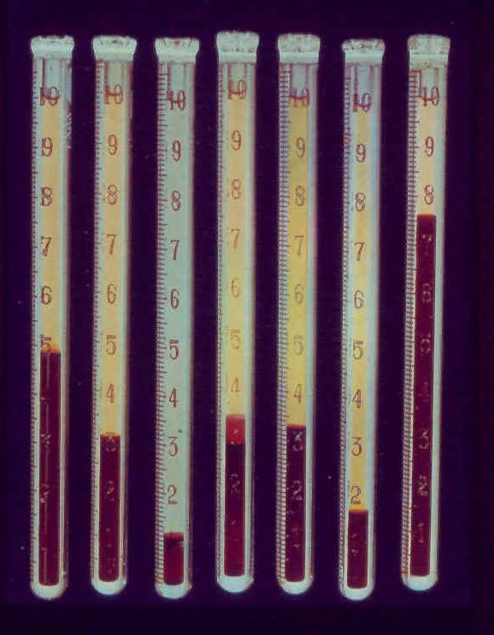
Hemolytic anemia: low hematocrit, plasma too yellow due to high bilirubin

Slide 9
Haemolisis
Extravascular
Intravascular
Hb
billiverdin
urobilin
Indirect bilirubin
Direct bilirubin
urobilin
stercobilin
Macrophages of the spleen
blood
Liver, bile
urea
feces
Free Hb
haemoglobin+ gaptoglobin
(α2-globulin)
Renal tubes
RES: spleen, lymph nodes and BM
ferritin, hemosiderin
Free Hb

Slide 10
Haemolysis signs | Intravascular | Extravascular
Haemolysis localization | Blood vessels | RES
Pathogenetic factor | Haemolysins, enzyme defect of RBCs | RBCs form anomalies
Liver and spleen enlargement | Insignificant | Significant
RBCs morphology | Anisocytosis | Microspherocytosis, elliptocytes, target-cells, sickle cells, etc.
Haemosiderosis localization | Kidney tubules | Spleen, liver, bon marrow
Lab signs of haemolysis | Haemoglobinemia Haemoglobinuria Hemosiderinuria | Hyperbilirubinemia, High stercobilin in faeces and urobilin in urea
Долгов В.В., Луговская С.А. 2001.

Slide 11
Membrane defects
Inherited
Altered red cell shape
Low red cell plasticity
Early red cell death in organs with high number of phagocytes.
In PNH (acquired condition) red cell shape is normal and haemolysis takes place in the blood vessels.

Slide 12
RBC Membrane

Slide 13
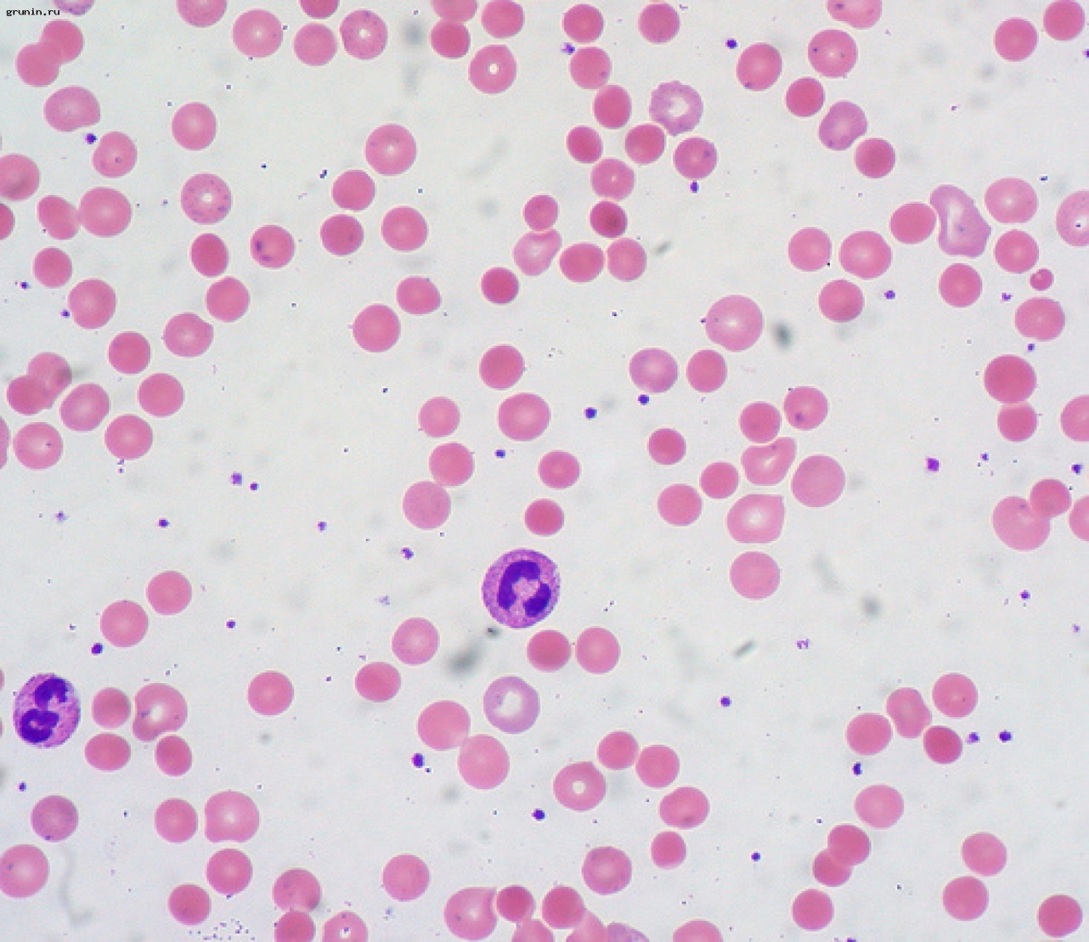
Hereditary spherocytosis (Minkovsky-Shaffar disease)
Incidence 1:4500 population
In the North Europe and America
Autosomal dominant

Slide 14
Spherocytosis pathogenesis
Lack of membrane proteins responsible for its permeability
↑ membrane permeability
Na⁺, aqua – into a cell
Red cell gets a sphere form

Slide 15
Spherocytes loose elasticity , cant change their form while passing through spleen sinuses
Either molder away or loose a part of the membrane and become microspherocytes
Haemolysis is extravascular

Slide 16
Clinics
Onset – in childhood
The course may be with severe relapsing haemolytic crises (provoked by infections)
Majority of the patients have moderate compensated haemolytic anaemia with jaundice, spleen enlargement and increased incidence of pigment gallstones

Slide 17
Complications
Clinical course may be complicated with Crisis:
Hemolytic Crisis: associated with infection
Aplastic crisis: associated with Parvovirus infection

Slide 18
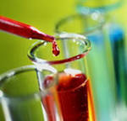
Spherocytosis diagnosis
Osmotic fragility test

Slide 19
Spherocytosis treatment
Splenectomy after 20 years old

Slide 20
Management:
Folic Acid 5mg weekly, prophylaxis life long
Spleenectomy
Blood transfusion in Ac, severe hemolytic crisis

Slide 21
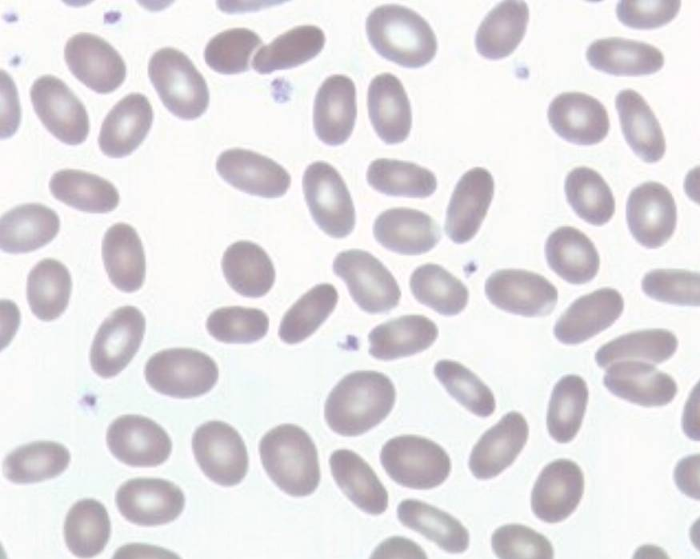
H Ovalocytosis/Elliptocytosis
Membrane defect is polarization of cholesterol or hemoglobin at ends and increased sodium permeability
Over 25% ovalocytes
Most asymptomatic
Mild anemia in 10-15%
H Ovalocytosis
Normocytic ovalocytes
Notes:
21
Hereditary Elliptocytosis/Ovalocytosis ‑ autosomal dominant.
1. Characterized by greater than 25% ovalocytes on the smear.
2. Membrane defect - polarization of cholesterol or hemoglobin at ends rather than around pallor and increased sodium permeability. Abnormal shape occurs in the mature RBC.
3. Most persons are asymptomatic with no anemia due to normal RBC lifespan. Normal Osmotic Fragility test.
4. 10‑15% develop a mild hemolytic anemia due to decreased RBC lifespan. Increased Osmotic Fragility test, increased retics. May treat with splenectomy if severe. [May be related to Hereditary pyropoikilocytosis.]

Slide 22
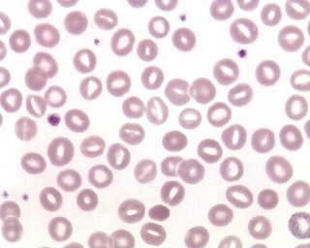
Hereditary Stomatocytosis
Membrane defect is abnormal permeability to sodium and potassium
Caused by edema
20-30% stomatocytes on blood smear
Mild to severe hemolytic anemia
H Stomatocytosis
Notes:
22
Hereditary Stomatocytosis ‑ group of inherited types.
1. Characterized by 20‑30% stomatocytes on the smear.
2. Membrane defect - abnormal permeability to sodium and potassium cause swelling.
3. Great variability in inherited types resulting in mild to severe hemolytic anemia. Increased Osmotic fragility test, increased retics. May remove spleen.

Slide 23
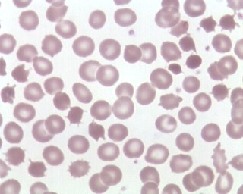
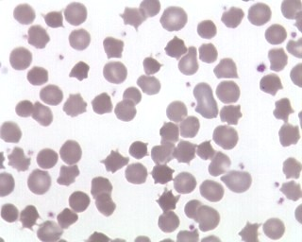
H Acanthocytosis
Defect is increased membrane cholesterol due to abnormal plasma lipids
Numerous acanthocytes on smear
Mild anemia
Also known as abetalipoproteinemia
H Acanthocytosis = Abetalipoproteinemia
Notes:
23
Hereditary Acanthocytosis = Abetalipoproteinemia – autosomal recessive inheritance. [abeta = no beta lipid transport proteins]
1. Characterized by numerous acanthocytes on smear.
2. Defect – often increased cholesterol in membrane due to abnormal plasma lipids.
3. Mild anemia, normal Osmotic Fragility test.
4. Serum contains no Beta lipoprotein to transport lipids.
5. Neurological and retinal abnormalities; impaired fat absorption.

Slide 24
Hemolobinopathies…

Slide 25
Haemoglobin defects
Normal haemoglobins:
HbA (α2β2) – 92-95%
HbА2 (α2δ2) – 1-3%
HbF (α2γ2) – 1-3%
Pathological haemoglobins:
HbH (β4)
Hb – Bart (γ4)
HbS (α2β(path)2)
Anomalies: either structure, or chains number

Slide 26
Sickle cell disease (SCD)
Homozygous condition by НвS (in RBCs there is НвSS)
HbS solubility is 20 times less than HbA solubility
Solubility lowens in its deoxygenated state (in the capillaries)
The insoluble chains of HbS crystallize in the red cells causing sickling → vascular occlusion.

Slide 27
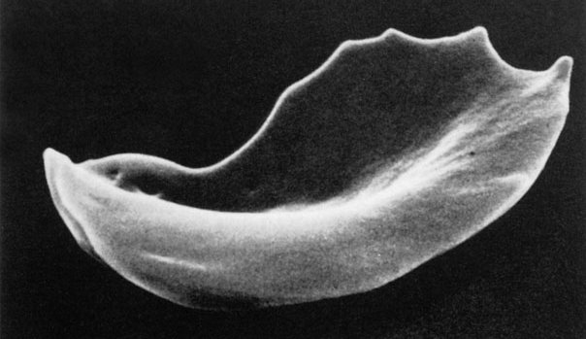
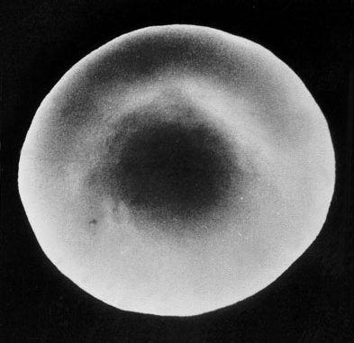
Sickle Cell
Normal red cell
Sickle cells inflexible, can’t do this

Slide 28
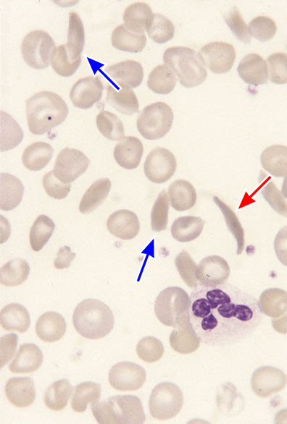
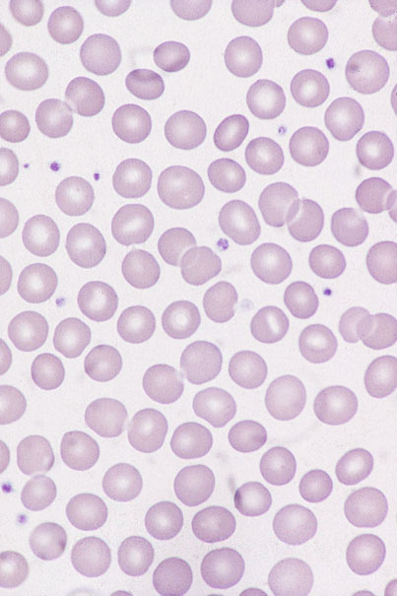
Sickle cell
Normal

Slide 29
SCD clinics
Vascular occlusion
Increased hemolysis
Symptoms usually present after 6 month of birth, when НвF disappear from the red cells.

Slide 30
SCD clinics
Multiorganic lesion (ischemia, pain, gangrenes, blindness).
Bones lesions are characteristic because of the low blood flow, which leads to the bones aseptic necroses.
Anaemia is mild, but tissue hypoxia is still present → asteniks, bone expansion, hypogonadism.
Hepatosplenomegaly .

Slide 31
Homozygous by HbS children have a fibrotic spleen because of its early clogging → septic complications from early age

Slide 32
Diagnostics
Blood film – sickle cells
Sickling test: to a sealed drop of blood Na2SO4 is added, which leads to hypoxia and the red cells with HbS become sickle cells
Haemoglobin electrophoresis

Slide 33
Treatment
Analgesia (including narcotics);
Low molecular weight polyglukin;
Desaggregants, direct anticoagulants;
Oral hydroxyurea (20–40 mg/kg/day). Although its precise mode of action is not known, it increases Hb F production, decreases intracellular Hb S concentration by increasing MCV, lowers the neutrophil count and inhibits prothrombotic interactions between sickle cells and the endothelium..

Slide 34
Thalassaemias
Homozigous β- thalassaemia
Heterozygous β- , homozygous α- thalassaemias
Haemolytic anaemia of different severity
Hepatosplenomegaly (extramedullar hemopoiesis)
Tower skull (extramedullar hemopoiesis)
Mild hypochromic anaemia
Haemolysis is absent

Slide 35
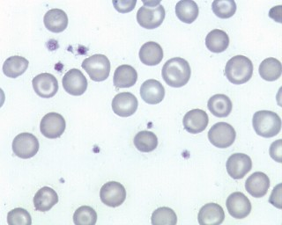
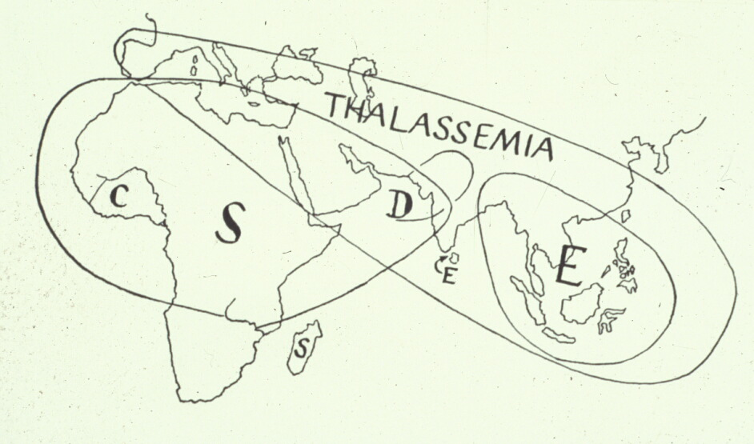
D. Thalassemias
Beta
Alpha
Target cells/Codocytes
35
Notes:
35
Thalassemias - Quantitative defect
Group of inherited disorders in which globin chains of normal structure are produced but the production rate of one type of chain is diminished....● decreased globin chain synthesis. All thalassemias are characterized by microcytic/hypochromic rbc's and target cells.
NOTE: Hemoglobinopathies - presence of variant hemoglobins (e.g. Hgb S) due to production of globin chains with abnormal structure…..a qualitative defect.
B. Thalassemias are genetic mutations classified according to the particular globin chain whose synthesis is suppressed.
1. Impaired beta chain synthesis = Beta thalassemias and impaired alpha chain synthesis = Alpha thalassemias
2. Occurs in Greek/Italian (beta), Asian (alpha) and African (both) ancestries.

Slide 36
β-thalassemias
Mediterranian, Central, East Africa, Middle East, India
reduced synthesis of β-chains
α-chains are unsoluble, they precipitate in erythroblasts (in the BM), destroying its membrane = ineffective erythropoiesis
A part of RBCs ripens, goes to the blood flow, where hemolysis takes place
Notes:
BM – bone marrow

Slide 37
β-thalassemias
Severity of β-thalassemia depends on the number of synthesized β-chains.
Cooley disease (thalassemia major) – the most severe form, complete lack of β-chains, β⁰-thalassemia (Hb up to до 30-50 g/l)
May be cured by alloBMT

Slide 38
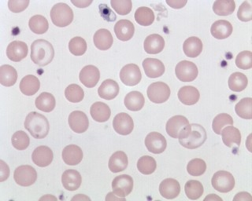
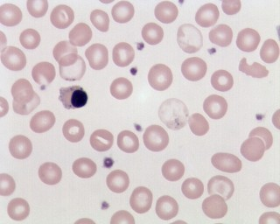
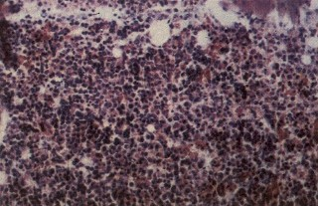
Beta Thal Major (Homozygous)
Blood smear
Howell-Jolly body
Target cells
NRBC
Pap bodies
Transfused RBC
Blood smear
Target cell
Transfused RBC
Hypercellular Bone Marrow (10x)
Notes:
38
Bone marrow:
Hypercellular due to ↑ RBC precursors; low M:E ratio; increased storage iron.
Treatment:
Used to rarely reach adulthood but therapy has improved.
a. Transfusion dependent (causes dimorphic blood picture).
b. Splenectomy (~4yo) – to keep rigid red cells circulating longer.
c. Iron chelating agents given to help iron overload problem.

Slide 39
Diagnostics
Anamnesis: haemolytic anaemia since childhood, hepatosplenomegaly
Target cells, hypochromia of RBCs
Electrophoresis shows prevalence of HbF, free α-chains

Slide 40
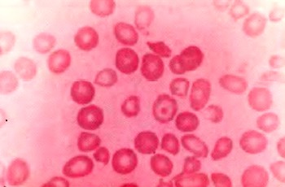
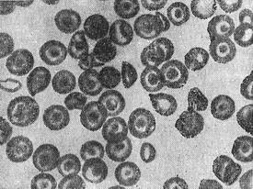
Target cells
Notes:
(У них окрашенная периферия, и на фоне светлой центральной части небольшой более темный сферический участок. Кодоциты характерны для альфа- и бета-талассемии, гемоглобинопатии С и S, свинцовой интоксикации, болезней печени, при длительной механической и обструктивной желтухе)

Slide 41
Treatment
alloBMT;
Hemotransfusions (Hb maintenance at 100-110 g/l);
Iron drugs are contraindicated;
chelators (exjade, desferal);
Splenectomy (enlargement > 8 under edge of the costal arch; increase of the need in RBS transfusions to more than 50% from the initial size during 6 months);

Slide 42
α-thalassemias
Lack of the α-chains syntesis;
Β-chains are well soluble;
Even homozygous forms have milder hemolysis and more effective erythropoiesis then in β-thalassemias;
Treatment is similar.

Slide 43
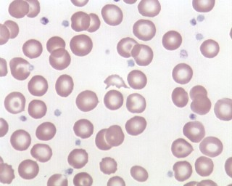
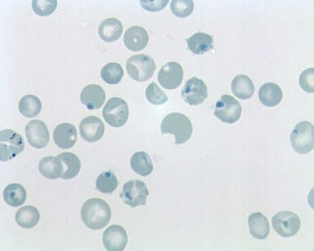
Alpha Thal Intermedia = Hgb H Disease
Three alpha genes deleted
Moderate decrease in alpha chains leads to beta chain excess…unstable Hgb H
Moderate anemia
Heinz bodies Excess beta chains Supravital stain
Target cells
Wright’s stain blood smear
Notes:
43
Hgb H disease = Alpha thalassemia intermedia
Deletion of three alpha genes, one normal gene (--/-α).
1. **Moderate decrease in α chains yields β chain excess.
a. Produces Hemoglobin H - composed of β4, an unstable hemoglobin which precipitates in red cells → Heinz bodies.
b. Rigid red cells with Heinz bodies are destroyed in spleen.
Lab findings:
a. MODERATE anemia - Hgb 8-9 g/dL, micro/hypo rbcs.
b. Targets, basophilic stippling; chronic lifelong anemia.
c. Hemoglobin electrophoresis:
▪Decreased hemoglobin A ~80%
▪Hemoglobin H 4-30%; Bart's hgb in cord blood.

Slide 44
Red Cell Enzymopathies
Physiology:
EM pathway: ATP production
HMP shunt pathway: NADPH & Glutathione production

Slide 45
Glucose-6-phosphate dehydrogenase (G6PD) deficiency
Patients develop HA when the red cells are exposed to oxidant stress, especially by drugs, infections, ingestion of fava beans and during the neonatal period
2 forms:
Mediterranean (more severe, enzyme deficiency is present in reticulocytes)
African (enzyme deficiency is present in old red cells)
Is dangerous by acute renal failure development.
Notes:
HA-haemolytic anaemia

Slide 46
(Reduced form)
(Oxidised form)

Slide 47
Clinical Features:
Acute drug induced hemolysis:
Aspirin, primaquine, quinine, chloroquine, dapsone….
Chronic compensated hemolysis
Infection/acute illness
Neonatal jaundice
Favism

Slide 48
Inv:
e/o non-spherocytic intravascular hemolyis
P. Smear: Bite cells, blister cells, irregular small cells, Heinz bodies, polychromasia
G-6-PD level
Treatment:
Stop the precipitating drug or treat the infection
Acute transfusions if required

Slide 49
2. Pyruvate Kinase Deficiency
AR
Deficient ATP production, Chronic hemolytic anemia
Inv;
P. Smear: Prickle cells
Decreased enzyme activity
Treatment:
Transfusion may be required

Slide 50
Autoimmune Hemolytic Anemias

Slide 51
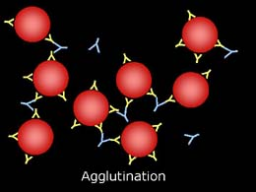
Direct Antiglobulin Test (DAT)
Have red cells been coated in-vivo with Ig, complement or both?
DAT can detect 100-500
molecules of IgG and
400-1100 molecules of C’
Polyspecific reagent
If positive, then IgG
and C3d specific reagents
DAT may be positive
without evidence of hemolysis;
Therefore clinical info important
http://www.vet.uga.edu/vpp/clerk/hiers/FIG5Slide3.JPG

Slide 52
Serologic Investigation of a positive DAT
Previous slide→ what proteins are coating the cell: IgG only, complement, or both
Test an eluate: remove the coating antibodies and test them against panel cells
Test the patient serum to identify alloantibodies that may exist to red cell antigens

Slide 53
Positive DAT may result from:
Autoantibodies to intrinsic red cell antigens
Circulating Alloantibodies bound to transfused donor cells
Alloantibodies in donor plasma containing products reacting with transfused recipient’s cells
Maternal Alloantibodies that cross the placenta and bind to fetal red cells
Antibodies against drugs on red cells
Non-red cell immunoglobulins bound to red cell (e.g. IVIG)
A positive DAT does not mean decreased red cell lifespan and therefore a history and physical is needed to determine the significance of a positive DAT

Slide 54
If there is no evidence of increased red cell destruction (anemia, ↑ reticulocytes, ↑ LDH, ↓ haptoglobin, hemoglobinemia, hemoglobinuria, etc), no further work-up of a positive DAT is necessary

Slide 55
Questions to ask…
Decreased red cell survival?
Has the patient been recently transfused?
Red cells, plasma containing products
Is the patient on any medications that can cause a positive DAT and hemolysis (e.g. penicillin, aldomet, cephalosporins)?
Has the patient received a transplant?
Is the patient receiving IVIG?
Is the patient pregnant? Is the patient a newborn infant?

Slide 56
Hemolysis
Def’n: Premature destruction of red blood cells that may be due to the intravascular environment or defective red cells
normal red cell life span is 120 days; decreased red cell survival studies
Def’n Immune Hemolysis: shortening of red cell survival due to the products of an immune response

Slide 57
Intravascular vs. Extravascular
Intravascular
red cells lyse in the circulation and release their products into the plasma fraction; obvious and rare
Anemia
Decreased Haptoglobin
Hemoglobinemia
Hemoglobinuria
Urine hemosiderin
Increased LDH
Extravascular
ingestion of red cells by macrophages in the liver, spleen and bone marrow
Little or no hemoglobin escapes into the circulation
Anemia
Decreased Haptoglobin
Normal plasma hemoglobin
Increased LDH

Slide 58
Classification
Warm Autoimmune (WAIHA)
70-80%
Cold Autoimmune (CAIHA)
20-30%
Mixed
7-8%
Paroxysmal Cold Hemoglobinuria
rare in adults
Drug Induced Hemolytic Anemia

Slide 59
Warm vs. Cold Auto
WARM
Reacts at 37 degC
Insidious to acute
Anemia severe
Fever, jaundice frequent
Intravascular not common
Splenomegaly
Hematomegaly
Adenopathy
None of these
COLD
Reacts at room temperature
Often chronic anemia
9-12 g/dL (less severe)
Autoagglutination
Hemoglobinuria, acrocyanosis and raynaud’s with cold exposure
No organomegaly

Slide 60
Warm Auto
Most are idiopathic (30%)
Older patients
Secondary (acute or chronic) (70%)
Malignancy esp. lymphoproliferative disorder
predominantly B-cell lymphomas
Rarely carcinoma
Autoimmune disorders (e.g. SLE)

Slide 61
WAIHA Serologic Investigation
DAT+
Anti-IgG only 20-60%
Anti-C3d only 7-14%
Both 24-63%
Antibody screen+
All panel cells+
Autocontrol+
50% of patients will have autoimmune antibody left over in the serum (DAT should be 4+)

Slide 62
WAIHA Serologic Investigation
Eluate: Remove antibody coating the patient’s red cells and react them with test cells
Panagglutinin >90%
Defined Specificity <10% (e.g. broad or narrow anti-Rh; anti-e, anti-LW)
Rarely other specificities such as Kell

Slide 63
WAIHA Underlying Alloantibodies
Remove antibodies coating the patient’s red cells
Incubate these uncoated cells with the patient plasma to adsorb autoantibodies
Repeat as many times as necessary to get autoantibodies out of plasma
React patient plasma, which should have all autoantibodies removed, with panel cells
Rule out underlying alloantibodies

Slide 64
Don’t wait to transfuse
Transfusion can be life saving in the setting of WAIHA and severe anemia or unstable clinical/cardiac status
Do not wait for “compatible blood”
Do not wait for underlying alloantibodies to be worked up (several hours) when the anemia is severe and life threatening
“Least incompatible”?

Slide 65
Therapy
B12, folate
Steroids
Prednisone 1-2mg/kg/day then taper when Hgb>10
Splenectomy
If non-responder to steroids
Rituxan
Plasmapheresis is not effective (IgG is extravascular; feedback may increase IgG)

Slide 66
Selection of Blood
ABO compatible
Negative for alloantibody and autoantibody specificity
Phenotype identical
All units will be incompatible → ?least incompatible

Slide 67
Cold Auto
16-32% of all Immune Hemolysis
Idiopathic (10%) Cold Agglutinin Disease
Secondary forms (90%);
Postinfectious
Mycoplasma
CMV
EBV; Infectious mononucleosis
Lymphoproliferative disorders
E.G. B-cell lymphomas; sometimes intravascular

Slide 68
CAIHA Serologic Investigation
Spontaneous agglutination in EDTA tube; difficulties with ABO typing
DAT+
>90% positive for C3d only
Antibody is usually IgM, binds in cold (periphery), then dissociates in warm
C3d may or may not shorten red cell survival
Antibody Screen+
Determine underlying alloantibodies using autoabsorption techniques

Slide 69
CAIHA Serologic Investigation
Specificity is I, IH or I (academic interest only)
Adult cells: I
Cord cells: I
Cold Agglutinin titers and thermal amplitude studies

Slide 70
Cold Auto Treatment
Again, with severe anemia or unstable disease, transfusion can be life threatening
Keep the patient warm
Transfuse through a blood warmer
Folate and B12
Treat underlying disease
Steroids usually poor response

Slide 71
Cold Auto Transfuse
ABO/Rh compatible units
Rule-out underlying alloantibodies and give antigen negative units
Crossmatch in warm
Again, transfuse through a blood warmer while keeping the patient warm

Slide 72
Paroxysmal Cold Hemoglobinuria
Idiopathic (rare)
Post-infectious (more common)
Occasionally seen in syphilis
Biphasic Hemolysin
IgG antibody that binds in the cold and fixes complement
At Warm temperatures, IgG dissociates and complement remains

Slide 73
PCH Serologic Investigation
DAT+ (>50%)
Usually IgG; sometimes C3d
Eluate often negative
Antibody screen w+
Antibody is panagglutinin with P or IH specificity
Donath-Landsteiner Test positive

Slide 74
Donath-Landsteiner Test (Biphasic Hemolysis)
 | 30’@4ºC 60’@37 ºC | 90’@4 ºC | 90’@37 ºC
Patient Serum | + | - | -
Patient Serum Normal fresh serum | + | - | -
Normal Fresh | - | - | -

Slide 75
PCH
Transfusion can be life threatening in the setting of severe anemia or clinical instability
Support with transfusions; B12 and folate
Corticosteroids not helpful
Treat underlying disorder
ABO/Rh compatible units

Slide 76
DIHA
Three types:
Haptenic (e.g. penicillin)
Immune Complex
Induction of Autoimmunity (e.g. aldomet, L-dopa, procainamide)

Slide 77
Haptenic (e.g. Penicillin, Cephalosporins)
Drug Coats cell; antibody directed against drug/red cell membrane
DAT+ for IgG and possibly complement
Eluate negative
Nonreactive for unexpected antibodies
Antibody eluted off red cells reacts with cells+drug but not cells alone
Hemolysis develops gradually
Discontinue the drug and red cell survival increases

Slide 78
Immune Complex (e.g. ceftriaxone)
Acute intravascular hemolysis; renal failure common
IgG or IgM antibody
Hemolysis due to drug/anti-drug immune complexes that associate with the cell membrane
Drug must be present for demonstration of this antibody

Slide 79
Drug-independent AIHA (e.g. alpha-methyldopa)
Drug on membrane alters the tertiary structure of the membrane
Antibodies are generated against the neoantigen induced by the drug
The drug does not need to be present for antibody detection if the membrane has already been altered.

Slide 80
AIHA treatment
Prednisolone 1 -2 mg/kg 2-3 weeks, with subsequent gradual reduction
Washed RBCs transfusions;
Cytostatics (6-MP 100-200 mg/ daily, cyclophosphamide, 400 mg in a day, vincristin 2 mg/week);
Human immunoglobulin intravenously 400-500 mg/kg daily 4-5 days);
Ciclosporin А 3 mg/kg daily;
Symptomatic treatment;
Plasmapheresis in cold AIHA type

Slide 81
Non-Immune Acquired Hemolytic Anemia
1. Mechanical Trauma
A). Mechanical heart valves, Arterial grafts: cause shear stress damage
B).March hemoglobinuria: Red cell damage in capillaries of feet
C). Thermal injury: burns
D). Microangiopathic hemolytic anemia (MAHA): by passage of RBC through fibrin strands deposited in small vessels → disruption of RBC eg: DIC,PIH, Malignant HTN,TTP,HUS

Slide 82
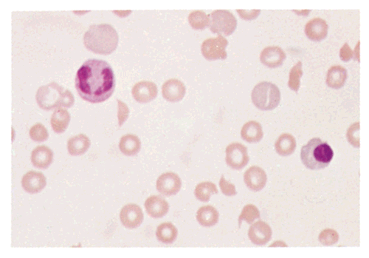
TRAUMATIC HEMOLYSIS

Slide 83
Acquired hemolysis
2.Infection
F. malaria: intravascular hemolysis: severe called ‘Blackwater fever’
Cl. perfringens septicemia
3.Chemical/Drugs: oxidant denaturation of hemoglobin
Eg: Dapsone, sulphasalazine, Arsenic gas, Cu, Nitrates & Nitrobenzene

Slide 84
The direct antiglobulin test was positive for complement (C3d) (++), and IgG (++-). Also was positive for agglutinins of IgM type and had a titer of 1:1024. Serologies for human immunodeficiency virus, hepatitis B and C viruses, and Mycoplasma pneumoniae were negative. Rheumatoid factor and antinuclear antibodies were undetectable.
Notes:
Case History

Slide 85
Prednisone therapy was started at a dose of 1 mg/kg intravenously, daily. Hemoglobin level rose to 11 g/dL, concomitantly with the improvement of hemolytic signs. A reduction of positivity of both direct and indirect antiglobulin tests (polyvalent serum + ; C3d + ; IgG+ ), as well as a reduction of cold agglutinin titers (1:128), was observed 8 weeks after corticosteroid therapy.
Notes:
Case History

Slide 86
Three months later, corticosteroids were tapered to a maintenance dose of 25 mg daily. Hemolysis recurred again with the fall of hemoglobin to 7 g/dL. The direct antiglobulin test recurred positive for polyvalent serum (+++), complement (+++), and IgG (+++), while cold agglutinin titers again became strongly positive (1:256).
Notes:
Case History

Slide 87
Immunophenotyping of bone marrow cells showed that 10% of all the cells were CD20 and CD19 positive. CD20 is widely expressed on B-cells. CD20 could play a role in Ca2+ influx across plasma membranes, maintaining intracellular Ca2+ concentration and allowing activation of B cells.
Notes:
Case History

Slide 88
Rituximab is a monoclonal antibody that binds to CD 20 Rituximab was started at the dose of 375 mg/mq once weekly, for a total of 4 doses Hemoglobin value reached 13.5 g/dL just before the third dose, although biochemical signs of hemolysis remained substantially unaltered.
Notes:
Case History

Slide 89
At the end of therapy, the hemolytic signs disappeared, the direct and indirect antiglobulin tests became negative, and cold agglutinin titers fell to 1:32 Immunophenotyping of bone marrow cells showed the absence of CD20 and CD19 B cells.
Notes:
Case History

Slide 90
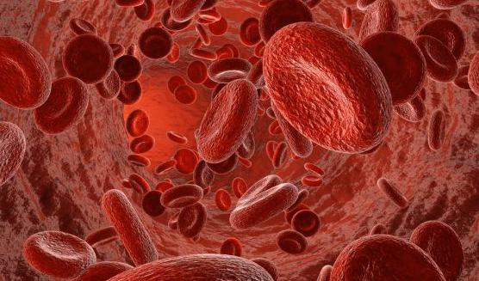
Thank you for attention

